Slide 1

HI I AM SUMAIYAH

Slide 2
Need some help???
Email me at Sumaiyah@nu.edu.pk Meet me in Basement Instructor Room Ext:257

Slide 3
Marks Distribution
Lab Participation: 10 marks
Quizzes: 30 marks (6*5 wtg)
Lab Mid-term Exam: 20 marks
Project: 10 marks
Lab Final Exam: 30 marks

Slide 4
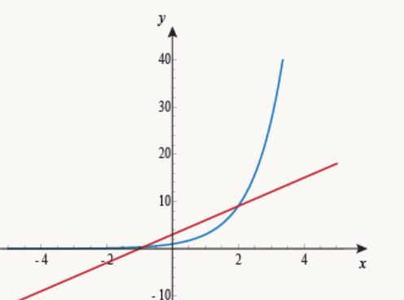
Key to get 4 GPA :D
Coursera
Khan Academy
Ted Talk
Technology
Education Curriculum

Slide 5

Sit back, Relax and enjoy Coffee
You need to do friendship by yourself…
Take it as a one-sided love
You have to sacrifice and suffer more

Slide 6
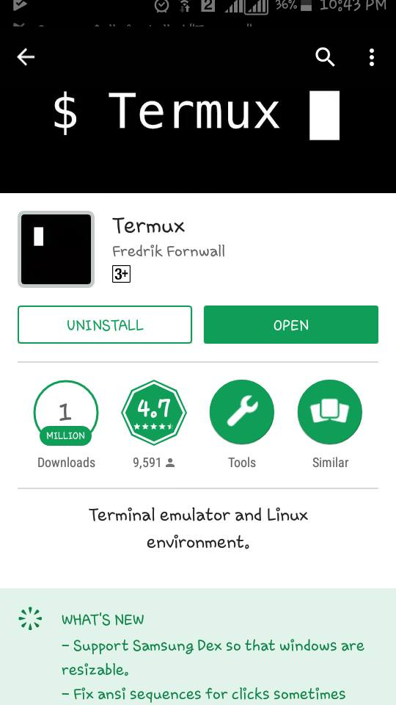
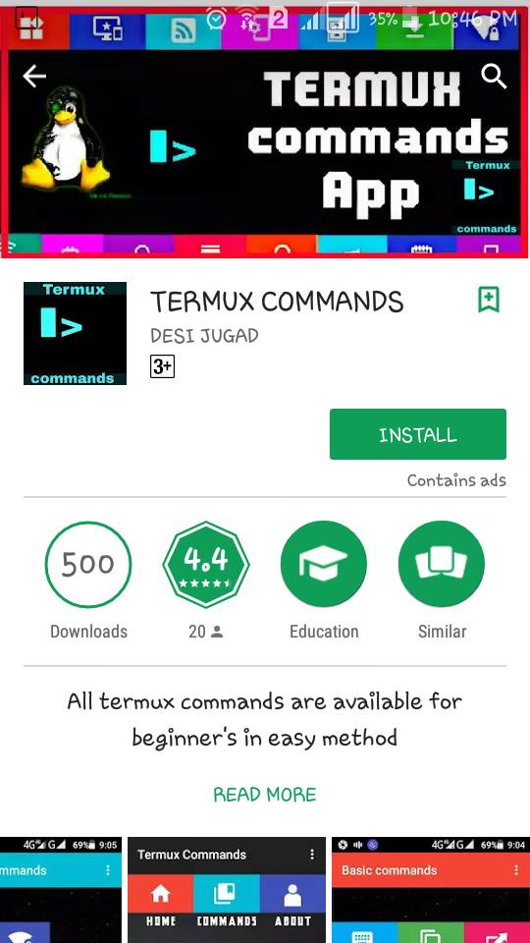
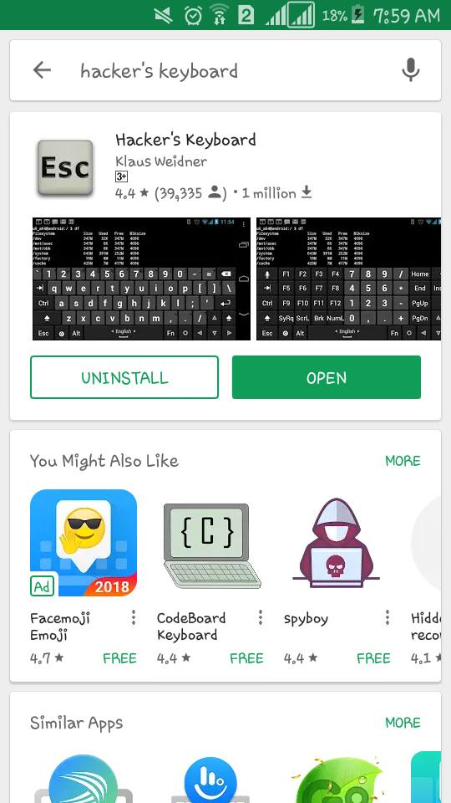
Android

Slide 7

IOS

Slide 8
Let’s move to Manual 1
Have A nice journey!

